Slide 1
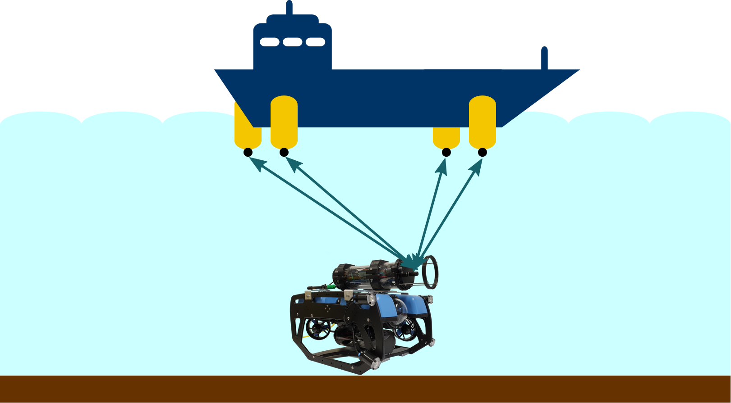

Orthogonal Codes for Acoustic Underwater Localization
Research Project by Sergej Keller
13-07-22

Slide 2


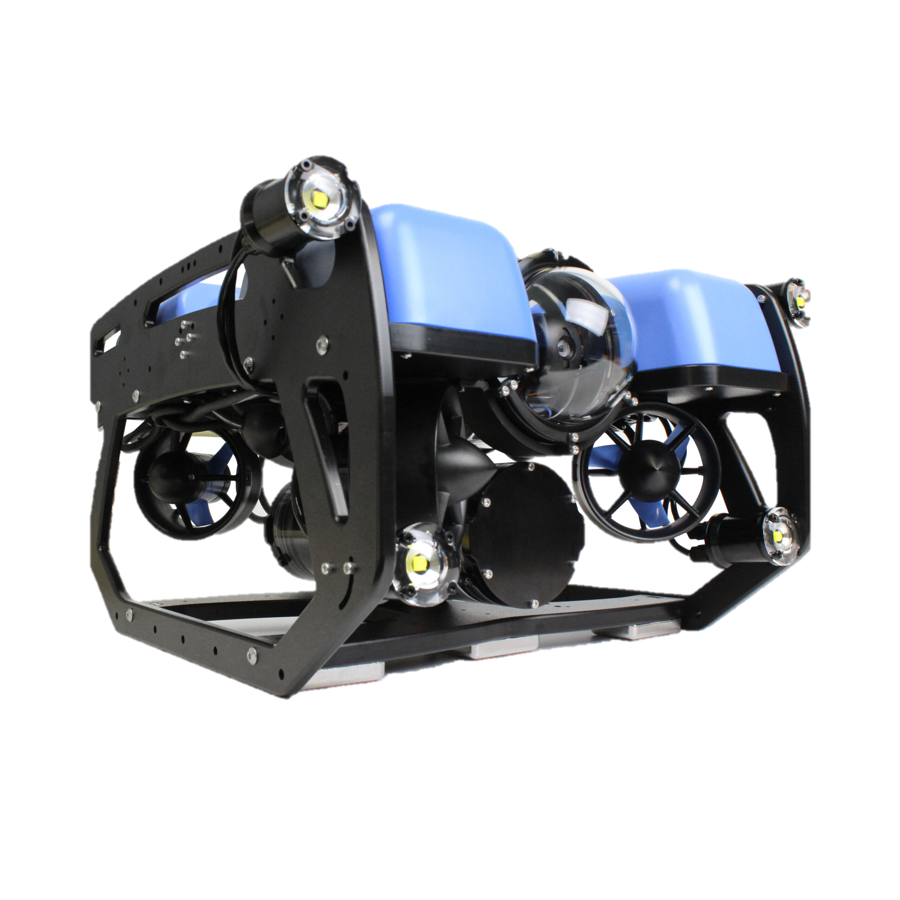
Motivation
Application Areas
Underwater Measurement
Subsurface Localization
Communication of ROV’s and other UV’s
BlueROV2
Affordable & high-performance modular underwater ROV
Remotely Operated underwater Vehicle
Rated for diving 100m
https://bluerobotics.com/wp-content/uploads/2016/06/IMG_6544-scaled.jpg

Slide 3
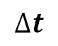
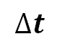
Setup
Base station
Acoustic signals
Multiple Anchors with known position
In most cases deployed at surface level
Propagation Delay
Used for measuring distances between ROV and anchors
Combined with multiple anchors absolute position prediction is achievable
$$∆t$$
$$∆t$$

Slide 4
Overview
2-way ranging (old) | one-way ranging
signal travels two times | signal travels once
signal processing at two levels | ROV receives or transmits to anchors only once
no synchronizing | synchronizing needed
two times the acoustic propagation delay | only one time the propagation delay

Slide 5
Overview
Orthogonal Codes
Mathematical: linear combination
Code Division Multiple Access (CDMA)
auto-correlation properties → enhanced detection
cross-correlation properties → improved separation from other sequences
Types of Orthogonal Codes
Pseudorandom Binary Sequences (PRBS)
Linear feedback shift registers
JPL Sequences (2 x LSFR)
Gold Codes
Kasami Codes
Walsh-functions
Notes:
Orthogonal codes used in cdma

Slide 6
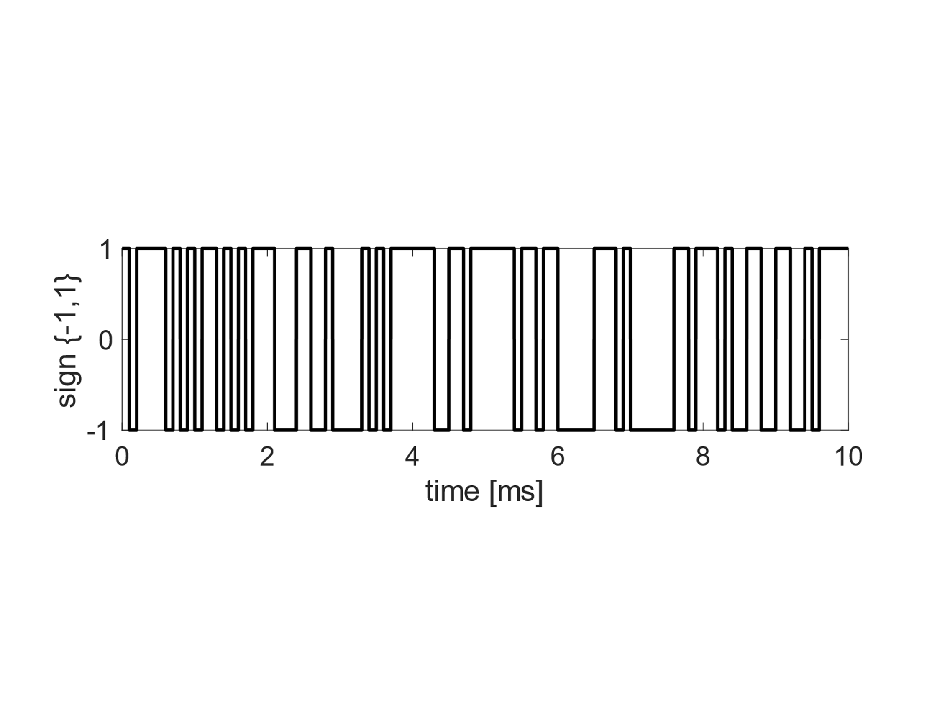
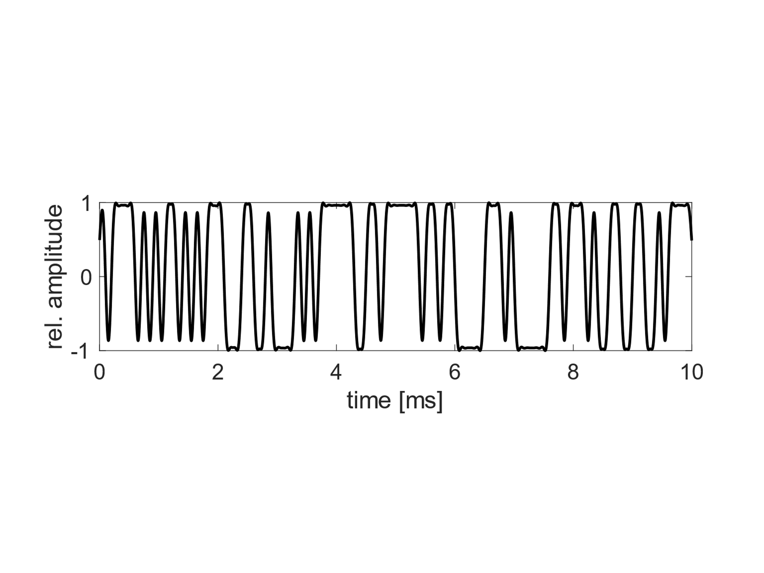
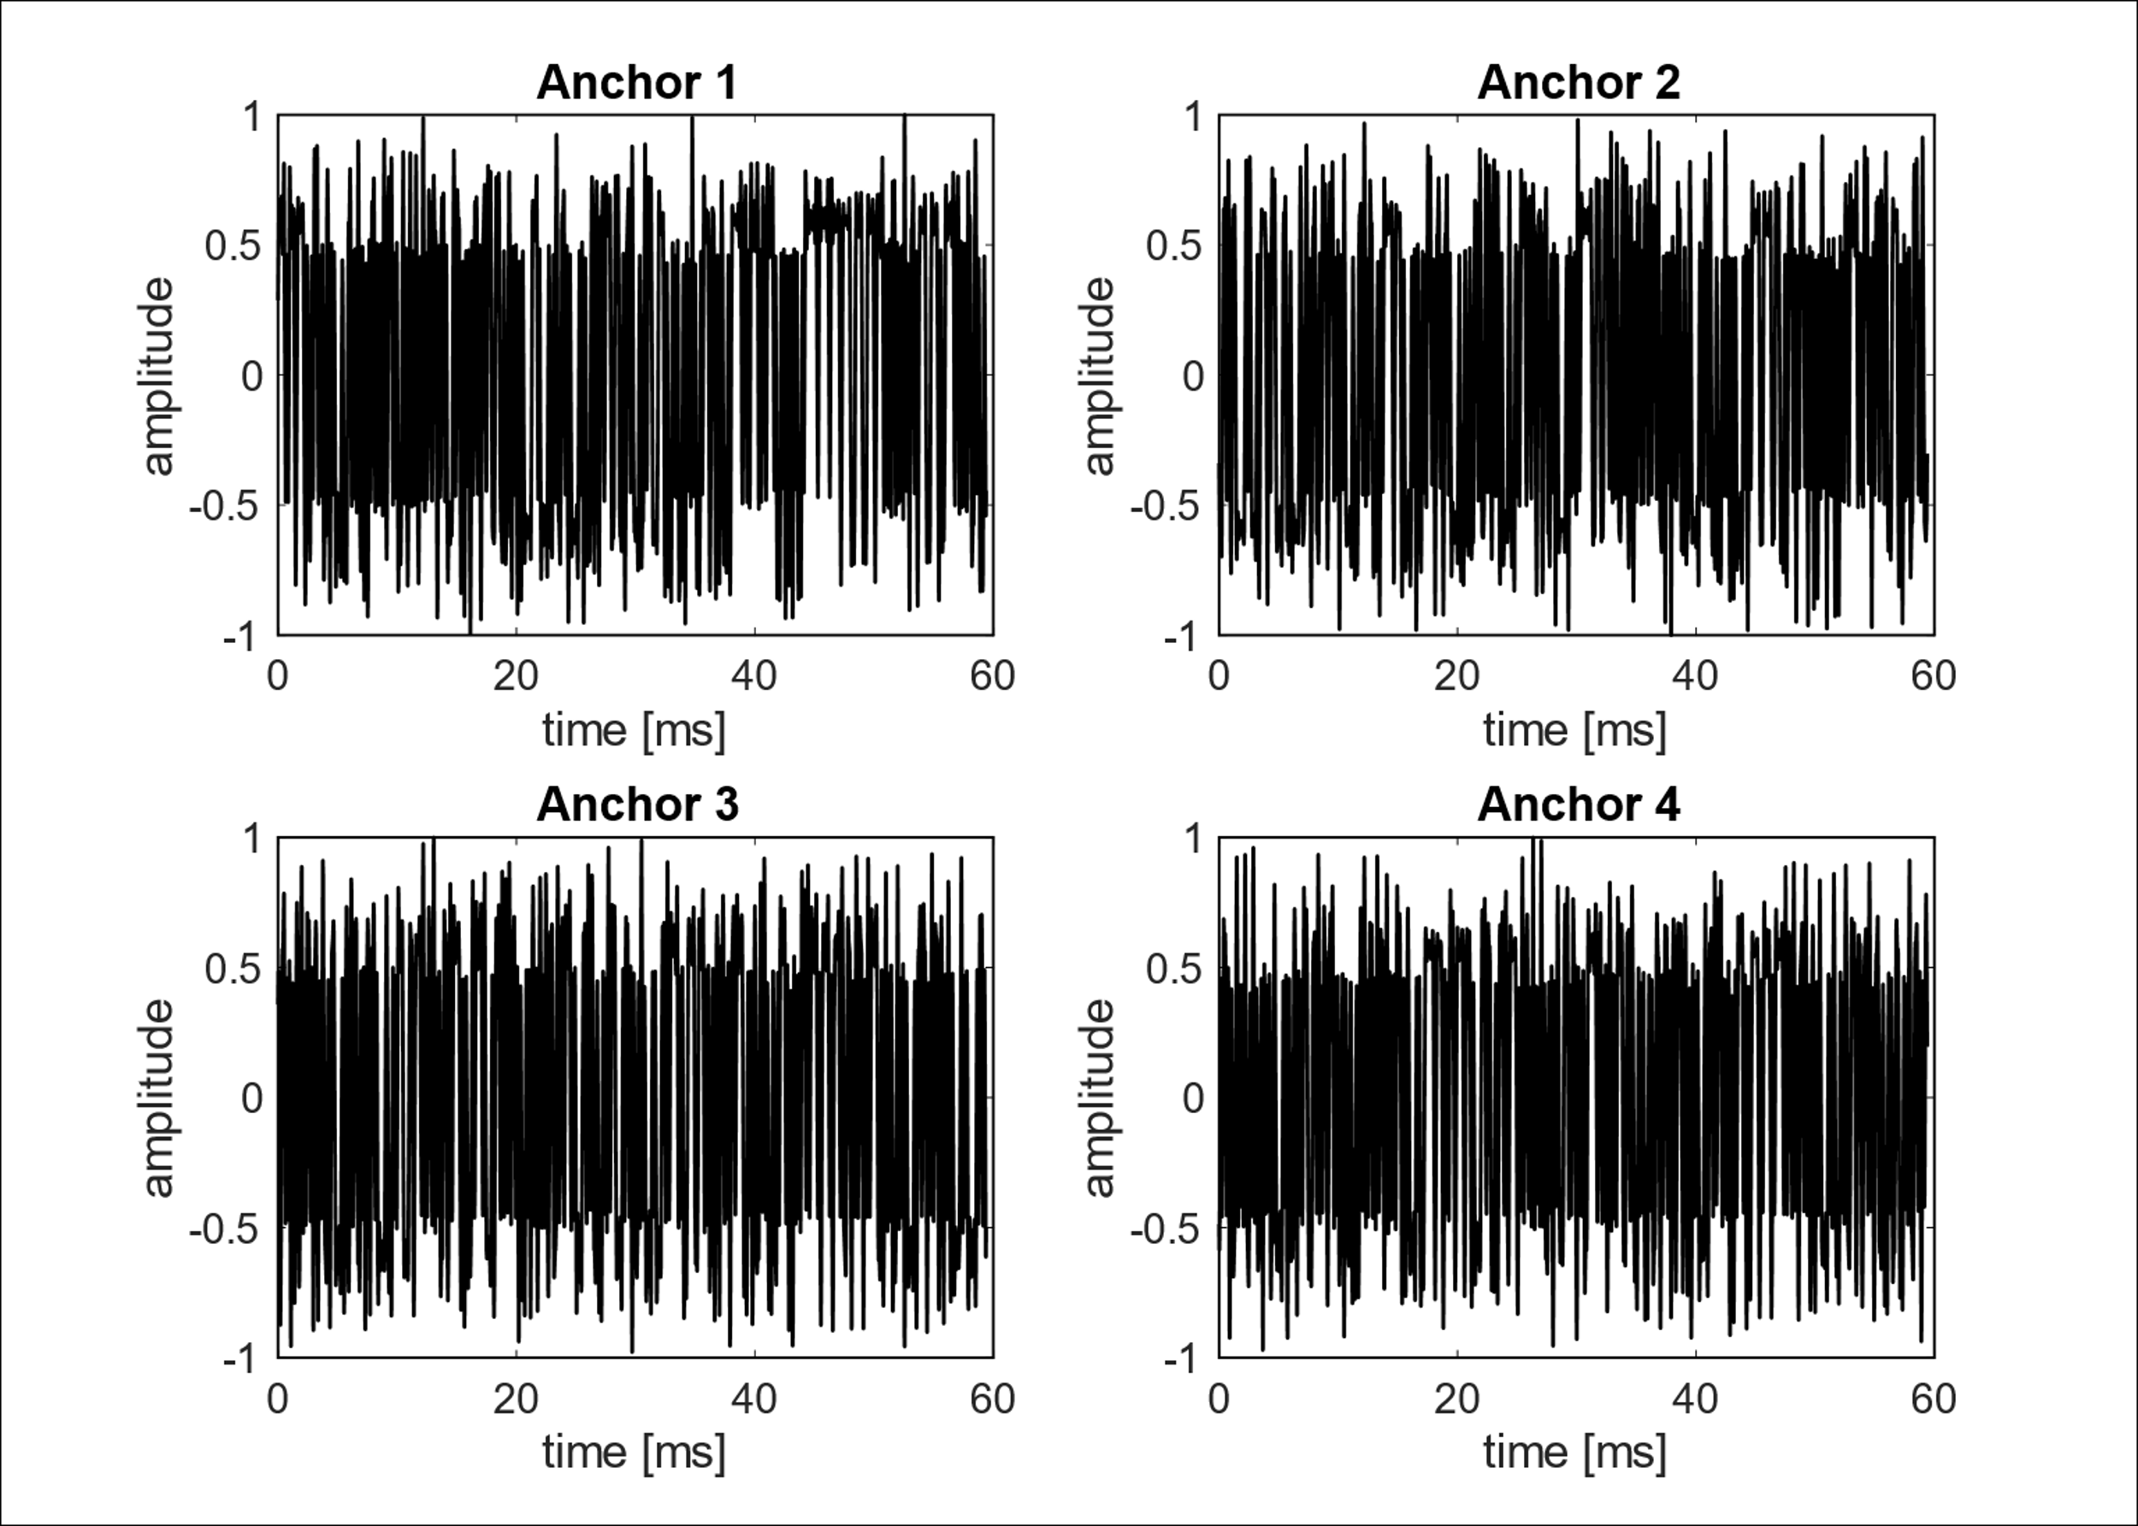
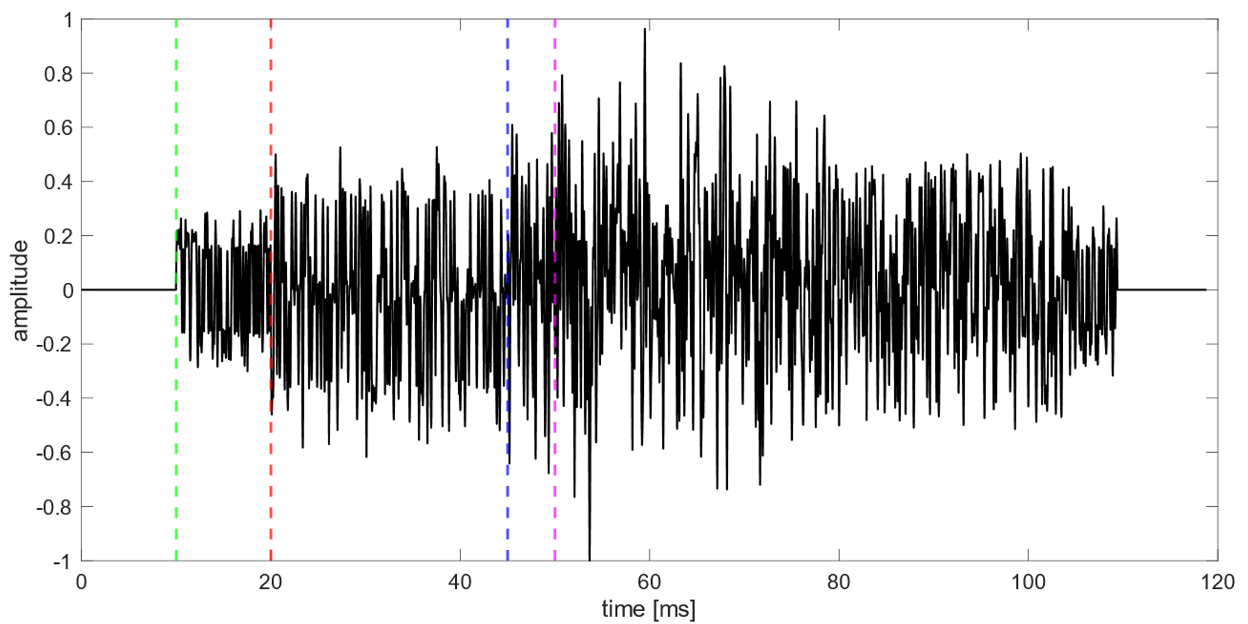
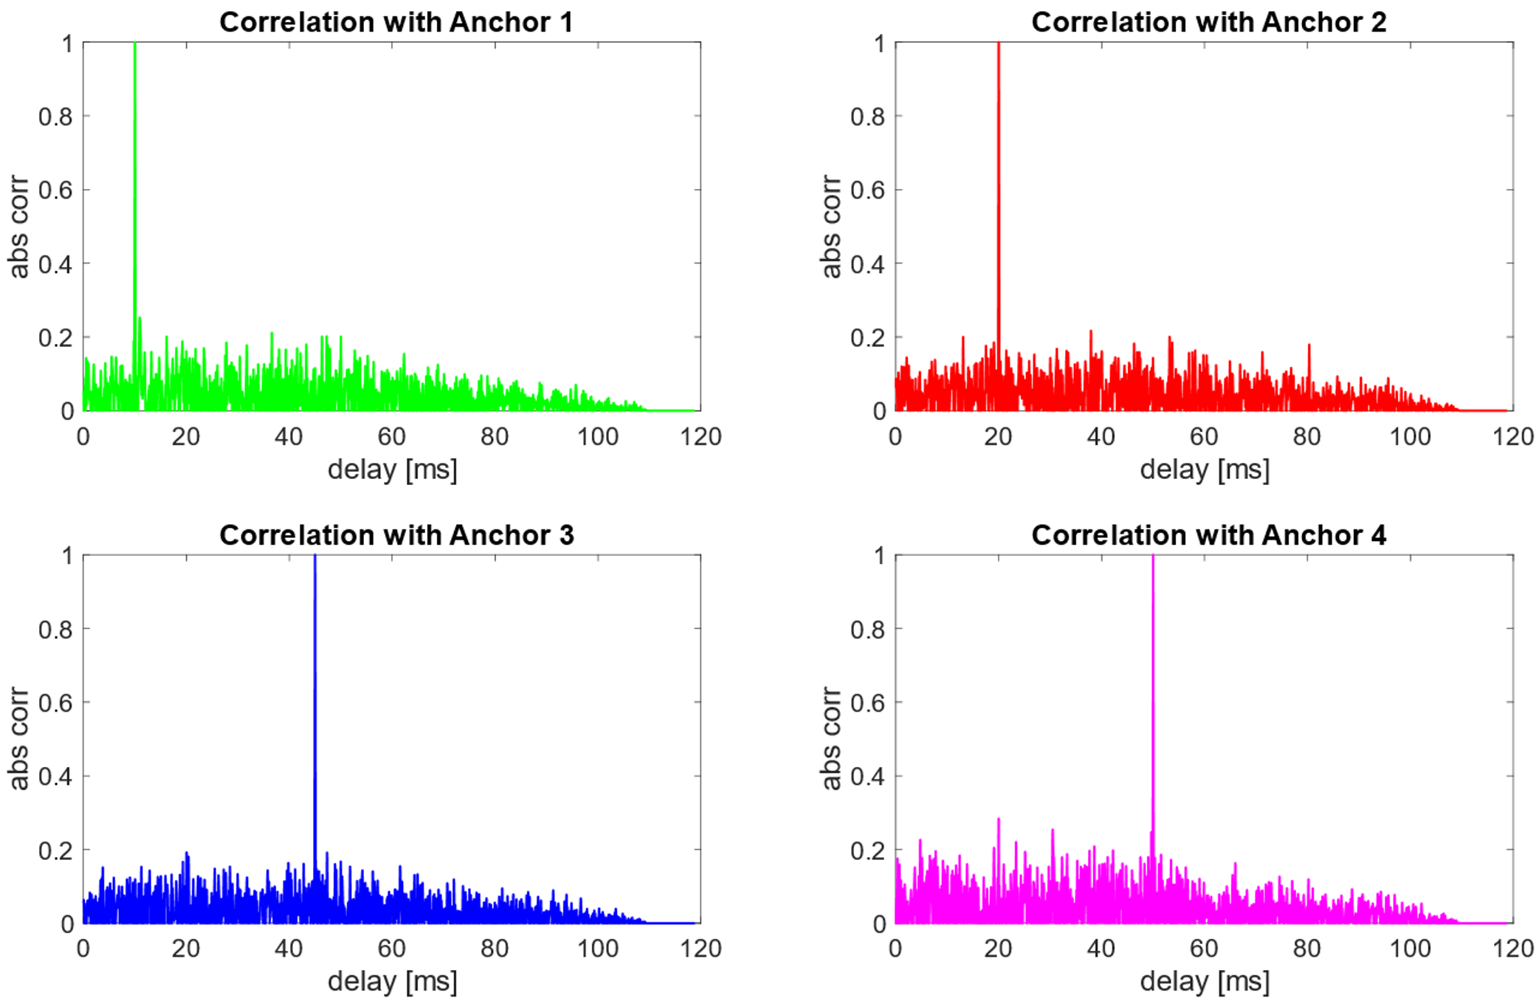
Principle – Outline
Generating orthogonal Codes
Apply Cosinus FIR
Anchors broadcasting Codes at base station
ROV receives Sum of codes
Calculate delay by max index value of cross-correlation

Slide 7
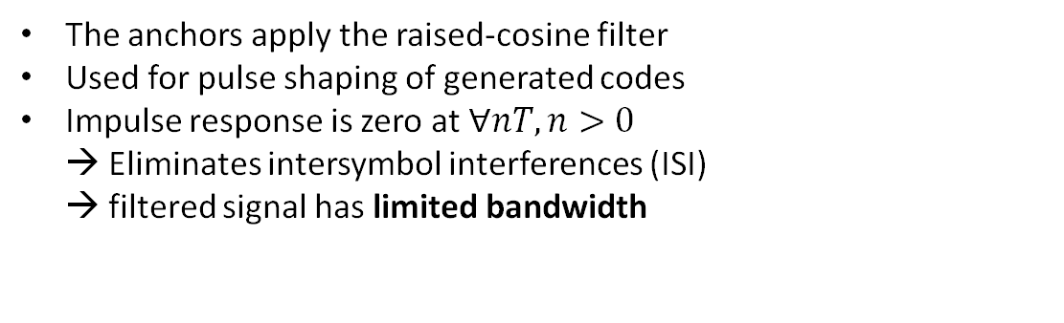
Principle – cosine FIR
The anchors apply the raised-cosine filter
Used for pulse shaping of generated codes
Impulse response is zero at $∀nT, n>0$ → Eliminates intersymbol interferences (ISI) → filtered signal has limited bandwidth

Slide 8
Principle – anchor codes
Sending at the same time

Slide 9
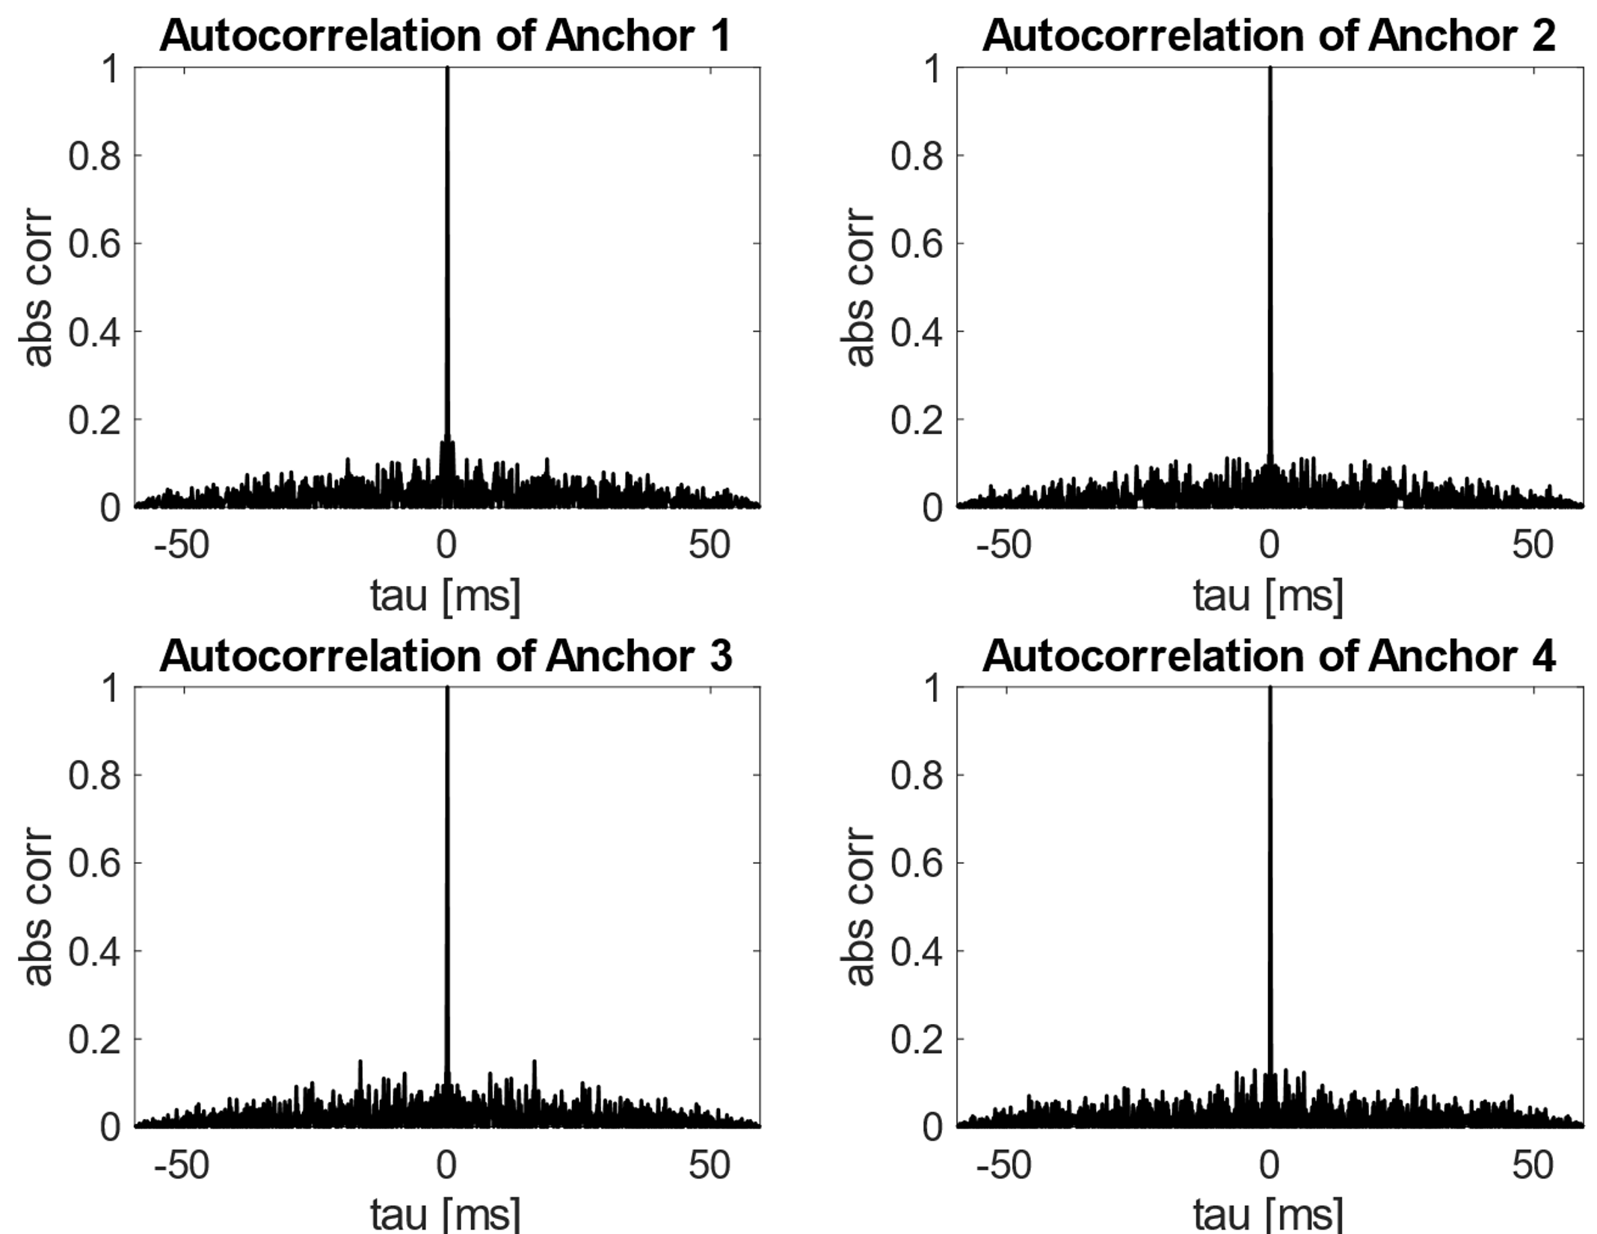
Principle – anchor codes
Sending at the same time

Slide 10
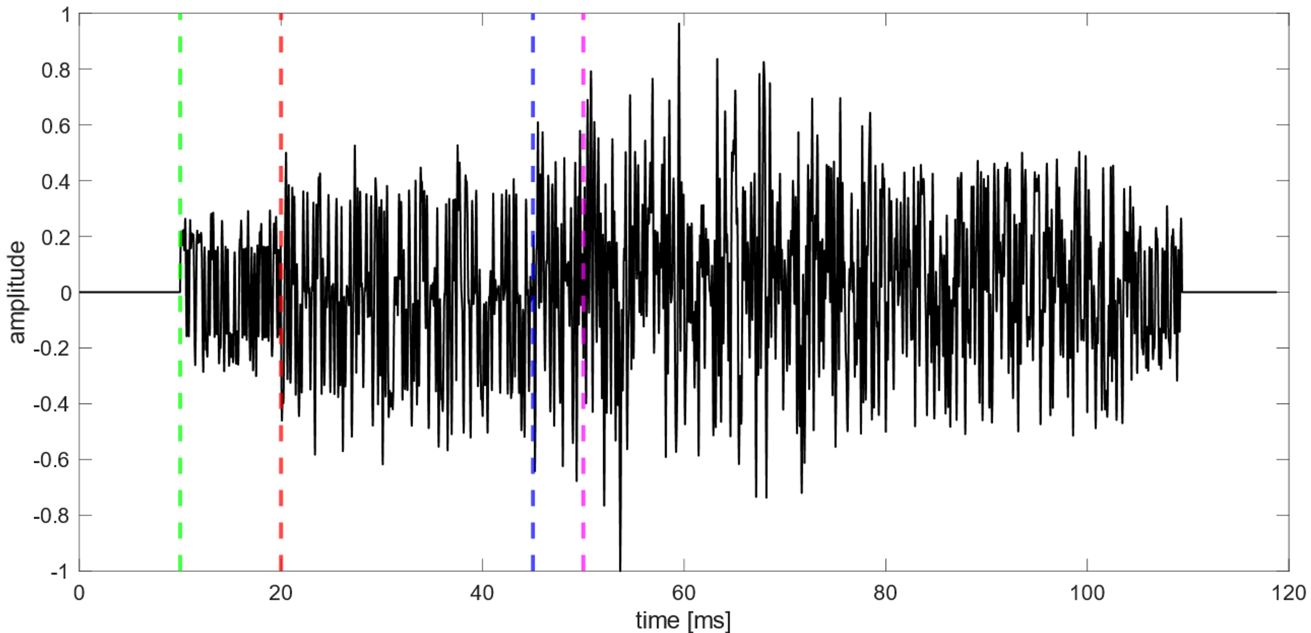
Principle – sum of codes

Slide 11
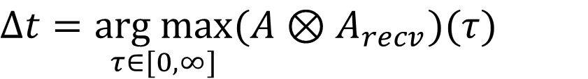
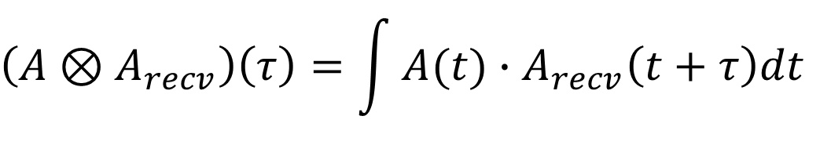
Principle – math of correlation
$$\left(A⊗A_{recv}\right)\left(τ\right)=\int{A(t)∙A_{recv}\left(t+τ\right)dt}$$
$$∆t=\underset{τ∈[0,∞]}{\text{arg} max}{(A⊗A_{recv})(τ)}$$

Slide 12
Principle – cross-correlation plots

Slide 13

Principle – correlation
$$⊗$$
The maximum of the resulting correlation coefficients shows the time delay (TDOA – Time Difference of Arrival)
Questions:
How can the relation between noise and peak be maximized?
How do certain parameters change this relation?
Can alternative PN Codes be used & are they even better?

Slide 14

Project Goals
Research Study on orthogonal (random) codes, modulation & processing
Applying different orthogonal code concepts
Tweaking available parameters und collecting results
Running different scenarios on available MATLAB simulation
Development and Implementation of a localization system in Python
Evaluation & Comparison of implemented Algorithms
Real world evaluation
Documentation of project

Slide 15
Roadmap
Phase I
06-22 to 7-22
Initial familiarization
Phase II
07-09 to 09-22
Analysis of relation between parameters
Phase III
09-22 to 12-22
Documentation of Code and Research (LaTeX)
Cross-correlation & orthogonality
Localization algorithms
Researching and Implementation in Python
Optimization of Scripts
MATLAB Simulation
Correct mistakes in Code and Docs
Final presentation
Motivational presentation
Selecting and testing different orthogonal codes
Final Evaluation
Superficial Research on orthogonal code types

